Slide 1
Computer Gaming, Entertainment and other Cool Applications

Slide 2
A Short History of Computer Video Gaming
https://www.youtube.com/watch?v=uuxoThzFPPw

Slide 3

An Early Computer Gamer 1983

Slide 4
Early Computer Games
Early Popular games were of the “Adventure” format that were played on the computer console of Mainframe Computers
Designed by Programmers for Programmers
“Adventure” by William Crowther
Star Trek
Text based, no graphics, player kept their own maps or notes
These games were designed and written by bored systems programmer to pass the time while waiting for programs to run

Slide 5
The Opening Line for “Adventure”
You are standing at the end of a road before a small brick building. Around you is a forest. A small stream flows out of the building and down a gully

Slide 6
Adventure
YOU ARE IN A SPLENDID CHAMBER THIRTY FEET HIGH. THE WALLS ARE FROZEN RIVERS OF ORANGE STONE. AN AWKWARD CANYON AND A GOOD PASSAGE EXIT FROM EAST AND WEST SIDES OF THE CHAMBER.

Slide 7
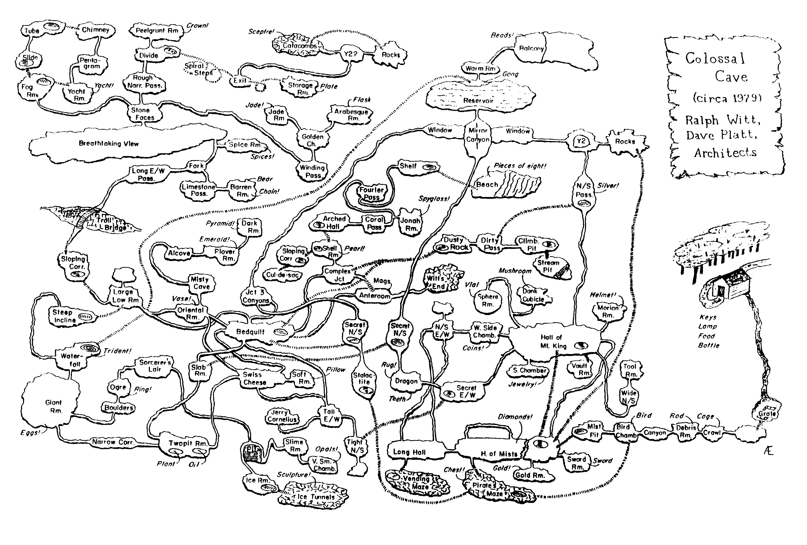
“Adventure” Map….
3188 × 2155
Pinterest

Slide 8
Star Trek Demo
https://www.youtube.com/watch?v=4p6qQEDp0Ug

Slide 9
The “Modern Era” (1969)
“PONG” is born
First “interactive” game for 2 players
Sometimes called “Computer Tennis”
Initially designed to be played on arcade systems, it was then adapted to the first home system that connected to a TV set

Slide 10
Pong Demo
https://www.youtube.com/watch?v=XNRx5hc4gYc

Slide 11
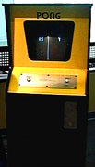
Pong, the first “video”game…1969

Slide 12

The Home Pong Machine sold by Atari…their first product!
Atari PONG

Slide 13
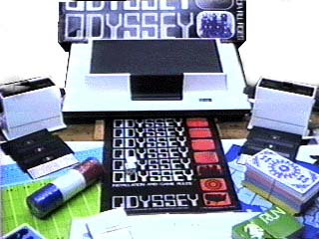
Magnavox Odyssey 1972
Used overlays that you adhered to the front of your TV to simulate graphics
Players had to keep their own score since the machine was not smart enough to do it for them!

Slide 14
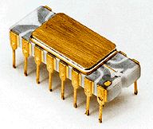
Intel 4004 Microprocessor - 1972
First commercially available micro-processor – first used in a programmable calculator
This technology made the personal computer possible
Contained 2300 transistors and ran at 100 khz

Slide 15
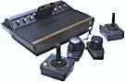
Atari 2600…1977
First Home Video Game with Plug in ROM cartridges
Color Graphics!
Joysticks!
Multi-Game
Establishes the Game Publishing Paradigm

Slide 16
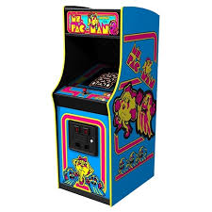

PAC-MAN !!
500 × 500
Ms. Pac Man Video Game
gameondallas.com

Slide 17
A Parade of Games and Game Conosoles
Asteroids
Tank
Breakout
Space Invaders
Pac-Man
Donkey Kong
Centipede
Frogger
Mario Brothers
Ultima
Quake
Doom
Microsoft Flight Simulator
Atari
Coleco
NEC
Commodore
Nintendo
Sega
Sony Playstation
Microsoft (X-Box)
Nintendo Wii

Slide 18
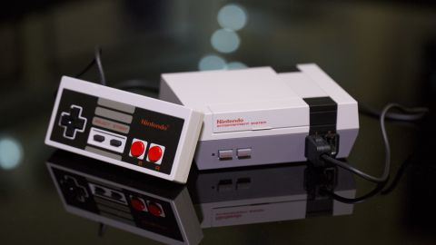
Nintendo Classic introduced several generations to Computer Games

Slide 19
And what game was played on the Nintendo?
Super Mario Bros. Giant Wall

Slide 20
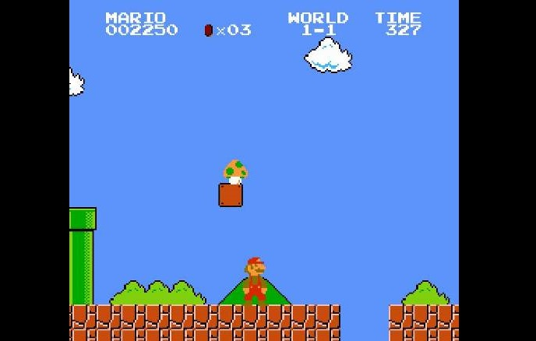
Super Mario Brothers!!!
Yes, somehow this only comes in eighth. The NES pack-in is the definitive videogame for a generation, and the first experience

Slide 21
Publishers Model
New Games were often released for Arcade and Home use simultaneously….
Industry has dozens of “Independent” game developers who conceive and create games at their own risk targeted towards one or more manufacturer’s consoles
They received royalties for games sold
Most of the profits are in the game cartridges, not the game console itself

Slide 22
Some Game Categories
Flight Simulators
Combat/Action
Adventure Games
Role Playing
Racing
Sports
Strategy
Board Games
Casino Games
Sim Games
Single Player
Multi-Player (MUDs)
Multi-Player online over a WAN such as the Internet
PC
Arcade
Console

Slide 23
Players today in U.S. for Console and PC games.
12,000,000 PC Computer Gamers
25,000,000 Console Gamers
5,000,000 Arcade Gamers
Business is worth about $10 Billion in U.S. alone
14 to 26 year old male dominated
Boys and their Toys!
73% of 7-29 year olds have played a computer game
In the U.S., sales of Computer Games outnumber books!
>150 Million Consoles in use Worldwide

Slide 24
Most Popular Games…so far
TETRIS
Mario Bros.
Minecraft
Grand Theft Auto
Wii Sports
Call of Duty
Halo

Slide 25

But, Mobile Gaming is the Growth Market !
Why YouTube sees you playing games on ...
thejournal.ie

Slide 26
Mobile Gaming-The Growth Market
193M Mobile Gamers in the U.S!
63% of them are women
Average time spent per day – 23 minutes
Candy Crush Saga top Grossing Game
$819M!!!
Global Mobile Gaming is a $68B business today!
Larger than the GDP of Costa Rica

Slide 27
Gaming Market Size
By the end of 2019, the global gaming market is estimated to be worth $152 billion, with 45% of that, $68.5 billion, coming directly from mobile games.
With this tremendous growth (10.2% YoY to be precise) has come a flurry of investments and acquisitions, everyone wanting a cut of the pie.

Slide 28
Computer Game Technology
Due to extreme price/performance pressure, video console game hardware is designed specifically for the purpose of running gaming software at lowest cost
As such, PCs don’t usually perform on games as well as these special “boxes”…but of course, PCs are much more versatile
Many game enhancement products exist for PCs however so that games can crossover to that market

Slide 29
Gaming Software
Much of the critical software is written in lower level code to enhance execution speed
Many of the gaming consoles have special machine instructions designed specifically for game functions

Slide 30

Physics Engines
Realistic Motion is achieved with specially
designed software “physics engines” that
perform the calculations for objects that are
moving through the game space at high speeds

Slide 31
Physics Engines
Libraries of programs that contain:
Physical Characteristics of the objects
Height
Weight
Mass
Velocity
Formulas for all possible combinations of reactions against that object

Slide 32
Physics Engines, don’t always have to follow the laws of Physics!
Sometimes you want to be able to take a left turn at 400 mph !!!!

Slide 33
Video Gaming Graphics
Seamless high resolution video processing is the key to high quality games today
Special video hardware that processes more megabits per second is the name of the game here coupled with very efficient vector graphics software

Slide 34

X-Box and PlayStation the Standards….today anyway

Slide 35
eSports!!
eSports describes the world of competitive, organized video gaming. Competitors from different leagues or teams face off in the same games that are popular with at-home gamers: Fortnite, League of Legends, Counter-Strike, Call of Duty, Overwatch and Madden NFL, to name a few

Slide 36

Team Competition
(Image credit: Riot/League of Legends)

Slide 37
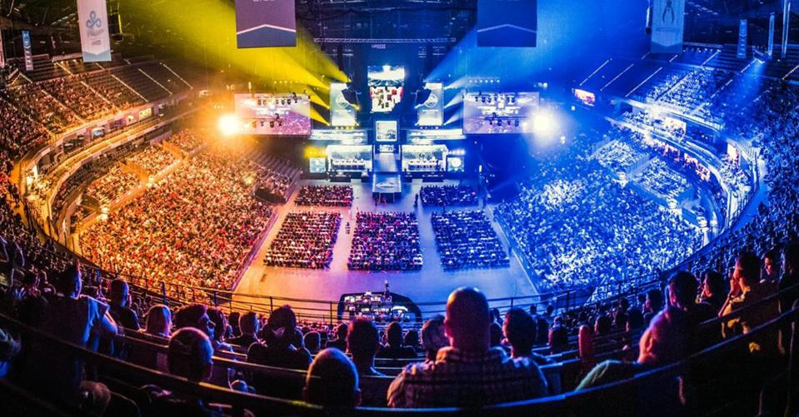
Huge Spectator Events
IBM
https://www.youtube.com/watch?v=m0zWiUGrzBk
IBM

Slide 38
Educational Games
Elementary and secondary schools use computers to play multimedia educational programs and teach kids to explore the Web for information.
Museums, CD-ROM encyclopedias, etc.
Computers can help students with special needs
Adapted Keyboards
Voice Command

Slide 39

Drawing by a nine year old using KidPix on a Macintosh Powerbook

Slide 40
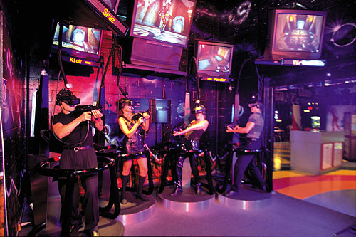
Virtual Reality

Slide 41
Augmented Reality
Adds essential information as you are looking at an object or a drawing…Guides you through the process
for example, Pokemon Go!
Or, repairing a car engine
https://www.youtube.com/watch?v=P9KPJlA5yds

Slide 42
Serious Games
Think Tanks use game theory extensively in exploring what/if situations dealing with:
Warfare
Economic behavior
Business Strategy
Social Behaviour
Ecological Impact
Supercomputers are often employed to explore millions of alternate scenarios and outcomes

Slide 43
Training and Simulation
Training programs can be expensive so some companies are choosing computer-based training (CBT).
Computer based training ranges from relatively simple on-line help systems to sophisticated virtual reality machines such as those used by the military and airlines to train pilots.

Slide 44
Boeing 777 Flight Simulator

Slide 45
Computing in the Arts
Dance: computers can be used to analyze the movements of dancers.
Painting: One can visit on-line museums and view famous and not so famous paintings. Some artists are also using the computer as a tool to create their art.
Digital Imaging
Digital Video
Digital Art

Slide 46
Music
The entire professional music generation chain is highly computerized
Digitization of original sound
Editing and manipulation
Storage
Multi-tracking
Mastering
Downloading / CDs / Streaming

Slide 47
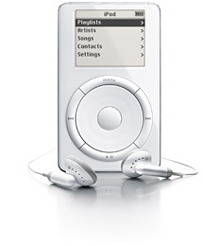

Music, Video and More in your pocket !
Introduced in 2001
400 Million Sold!

Slide 48
Computers in the Movies
Animation
Special Effects
Editing
Storage
DVD Mastering, Compression and Playback

Slide 49

Computer Generated Imaging and Effects

Slide 50
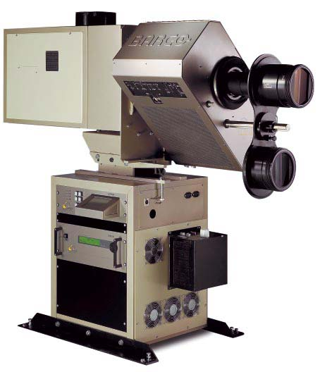
Digital (Filmless) Cinema!

Slide 51

Imagineering
Alien Abduction

Slide 52
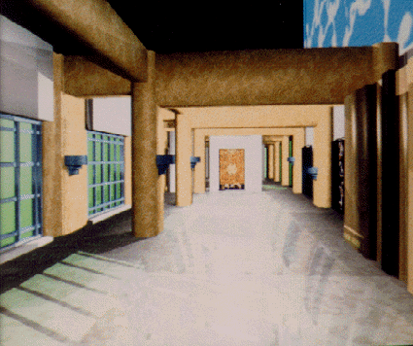
Architecture

Slide 53
And Finally, TV

Slide 54




Interactive High Definition Digital TV

Slide 55
High Definition Digital TV
HDTV standards being rolled out and completed nationwide since 2008
Older TVs are obsolete and need digital converters to receive over the air signals af
HDTV has 6 times the resolution of standard TV

Slide 56
Interactive Digital TV
A highly interactive medium available to practically every household in the via the Open Cable Stds.
An ability to converge interactivity with live programming in a way in which the viewing public can participate in real time
Net result: An engaging consumer experience

Slide 57

By 2018, 200 million homes had access to Digital Interactive TV.
The FCC mandated Open Cable Standards require Set Top Box compatibility across ALL cable systems by 2006
Open Access to alternate networks
The Set Top Box becomes the Computer, the Router, the Playstation and the Digital Recorder all rolled into one

Slide 58
iTV Applications
Video on Demand (500-1000 Mpeg2 channels)
Information Enhancement
Provides viewers with additional information that enhances the TV show on TV
Viewer polling becomes part of the content
Commerce Applications (T-Commerce)
Provides viewers with the capability of buying goods & services while watching TV
Financial Services

Slide 59
iTV Applications
Games, Games, Games
Provides viewers with the capability to interact with the TV show content
Game shows,
Sweepstakes,
Voting
Internet Access ( Web, Mail, Chat, etc)
Home to Home Videoconferencing

Slide 60
The Interactive Cable Box
Functionality of a PC, DVR and Home Media Center, all in one
High definition video (1920 X 1080)
Supports on demand Pay Per View
Download any video or audio content in the library including games
Record anything at anytime
Full Internet Access

Slide 61
TV and Computing Converging at last!!
This much discussed event is now starting to occur.
Hi-def TVs allow computer grade images
The new computer screen will be 24” and larger
Thousands of channels will be available over the internet
Practically anyone can be a broadcaster

Slide 62
Internet Television
http://wwitv.com/portal.htm

Slide 63

All of this computer power and connectivity has given birth to another vital industry
GeekSquad.com !

Slide 64
https://www.youtube.com/watch?v=uuxoThzFPPw
Questions?

